Slide 1
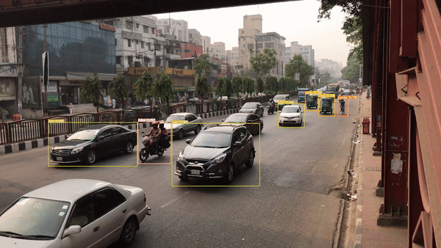




3929_Video Based Vehicle Detection and Tracking using
Image Processing and Deep Learning
Supervised By:
Dr. -Ing Nusrat Jahan Lisa
Presented By:
Sabbir Ahmed 170104011
Lamia Anjum 170104023
Farhana Akter Tumpa 170104042
Sabiha Benta Sayed 170104051
03.01.2022

Slide 2

Introduction:
In this presentation, we propose a traffic surveillance system to detect vehicles from pre recorded video. To-
● Categorize vehicles
● Estimate vehicle speed
● Monitoring traffic flow
● Analyze traffic for transporting planning

Slide 3
Insert Video
Divide input into different Regions
Take each section individually to work
Train using Deep Learning Models
Overview
Classify into Classes
Detect Vehicles
Labeling Vehicles
Tracking Vehicles
Count Vehicles
Vehicle Speed Estimation

Slide 4
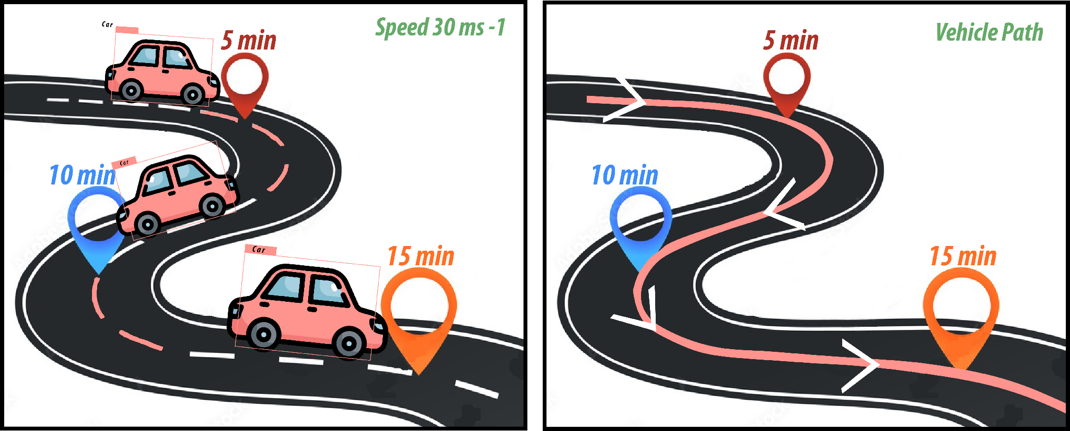
Background Studies
What Vehicle Detection and Tracking?
Fig: Vehicle Tracking and Detection

Slide 5
Background Studies Continues...
Literature Review
●In [1] authors gave the detailed overview of object motion detection , classification and tracking algorithms are presented and also their strengths and weakness of the various algorithms are discussed.
●In [2] authors gave a concise overview of image processing methods and analysis tools which are used in building the applications that is involved developing traffic surveillance systems.
●In [3] authors proposed a approach YOLO for object detection as a regression problem to spatially separated bounding boxes and associated class probabilities.
●In [4] authors proposed a approach Mask R-CNN efficiently detects objects in an image while simultaneously generating a high-quality segmentation mask for each instance.

Slide 6
Background Studies Continues...
Literature Review
●In [5] authors proposed a approach SSD (Single Shot MultiBox Detector) for detecting objects in images using a single deep neural network.
●In [6] authors proposed a simple and scalable detection algorithm is proposed that improves mean average precision.
●In [7] authors proposed a new traffic surveillance system that works without prior, explicit camera calibration, and has the ability to perform surveillance tasks in real time.

Slide 7
Background Studies Continues...
Deep Learning in Object Detection
● State of art for object detection
● Deep learning based object detection methods have 2 parts:
1. Encoder: taking image as input pass to different layers
2. Decoder: predicts bounding box and labels
●Popular deep learning models are: RCNN, YOLO , SSD

Slide 8
Background Studies Continues...
Deep Learning in Object Tracking
program takes an initial set of object detections and develops a unique identification for each of the initial detections.
Object tracking levels can be classified into two categories:
1. Single Object Tracking and
2. Multiple Object Tracking
● Popular deep learning models are: GO-TURN , ROLO, DeepSort , Yolo V5, MDNet,
KCF Tracker, Median Flow Tracker

Slide 9
Deep Learning Models in Vehicle Detection (YOLO)
YOLO employs convolutional neural networks (CNN) to detect objects.
YOLO algorithm works using the following three techniques:
●Residual blocks- grid cell will detect objects that appear within them
●Bounding box regression-to predict the height, width, center, and class of objects.
●Intersection Over Union (IOU)- eliminates unnecessary bounding boxes
Different version: YOLO, YOLO v2, YOLO v3, YOLO v4, YOLO v5

Slide 10
Deep Learning Models in Vehicle Detection (MASK R-CNN)
●Part of RCNN family
●Improved version of faster RCNN
●Input image is divided into 200 region sections and then a convolutional neural network is applied for each region
●2 types of segmentation: semantic segmentation & instance segmentation
●Pixel to pixel alignment between input and output
●Mask RCNN outputs : label , bounding box and object mask

Slide 11
Deep Learning Models in Vehicle Detection (SSD)
●One single shot to detect multiple image
●A feed forward convolutional network that produces a fixed size collection of bounding boxes
●It’s composed of two parts:
1. Extract feature maps
2. Apply convolution filter to detect objects

Slide 12
Deep Learning Models in Vehicle Tracking (DEEPSORT)
It is an extension to SORT (Simple Real time Tracker)
Multiple Object Tracking Algorithm
accelerates tracker speed by using - 2 algorithms
Deep Sort model has four stages –
1.detection stage
2.feature extraction/motion prediction stage
3.affinity stage
4.association stage.
DeepSORT tracks items using two metrics: IOU & Appearance matric

Slide 13
Deep Learning Models in Vehicle Tracking (GOTURN)
GOTURN, short for Generic Object Tracking Using Regression Networks
a single object tracker
an offline learning tracker based on CNN
employs a regression-based technique
it takes two cropped frame as input.
1. Target image
2. Search Image
frames pass through a bank of convolutional layers & find the bounding box of current frames

Slide 14
VEHICLE
COUNT
&
SPEED
ESTIMATION

Slide 15

VEHICLE
COUNT
&
SPEED
ESTIMATION

Slide 16
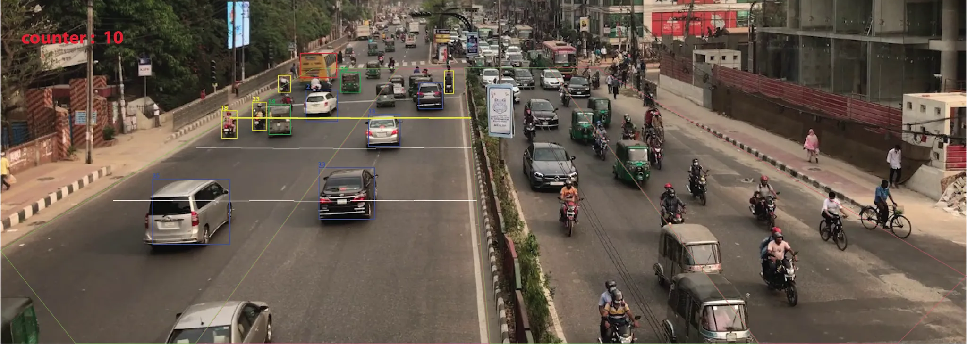
Fig: Vehicle Speed Estimation and Counting

Slide 17
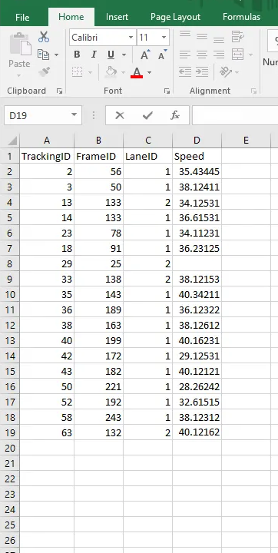
Fig: Vehicle Speed Value in Excel

Slide 18
Mask R-CNN
Data Collection
Data Annotation
Training Deep Learning Models with Trained Data
SSD
YOLO v5
Workflow
Choosing The Best Model
Accuracy Check for Detection
Model Evaluation with Test Data
DeepSORT
Speed and counting
Tracking Data
GO
TURN

Slide 19
How We Created Our Customized Dataset ?

Slide 20

STEP 1 :
We take our pre recorded videos as input.

Slide 21
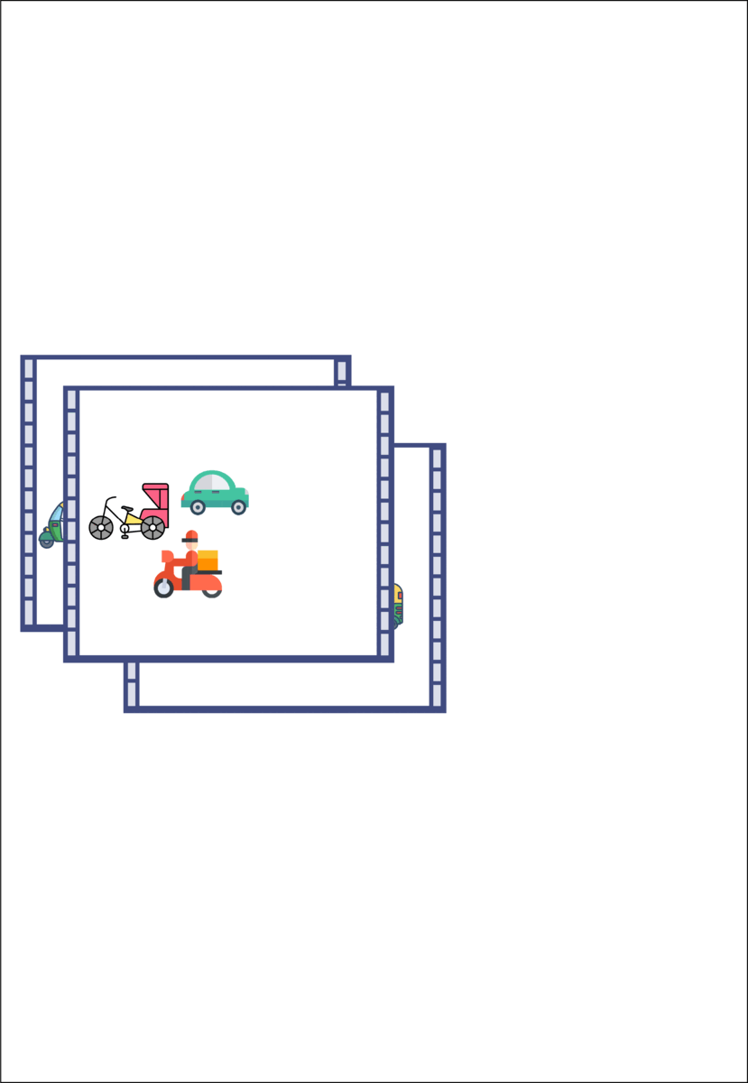
STEP 2 :
From those videos, we have generated images.

Slide 22
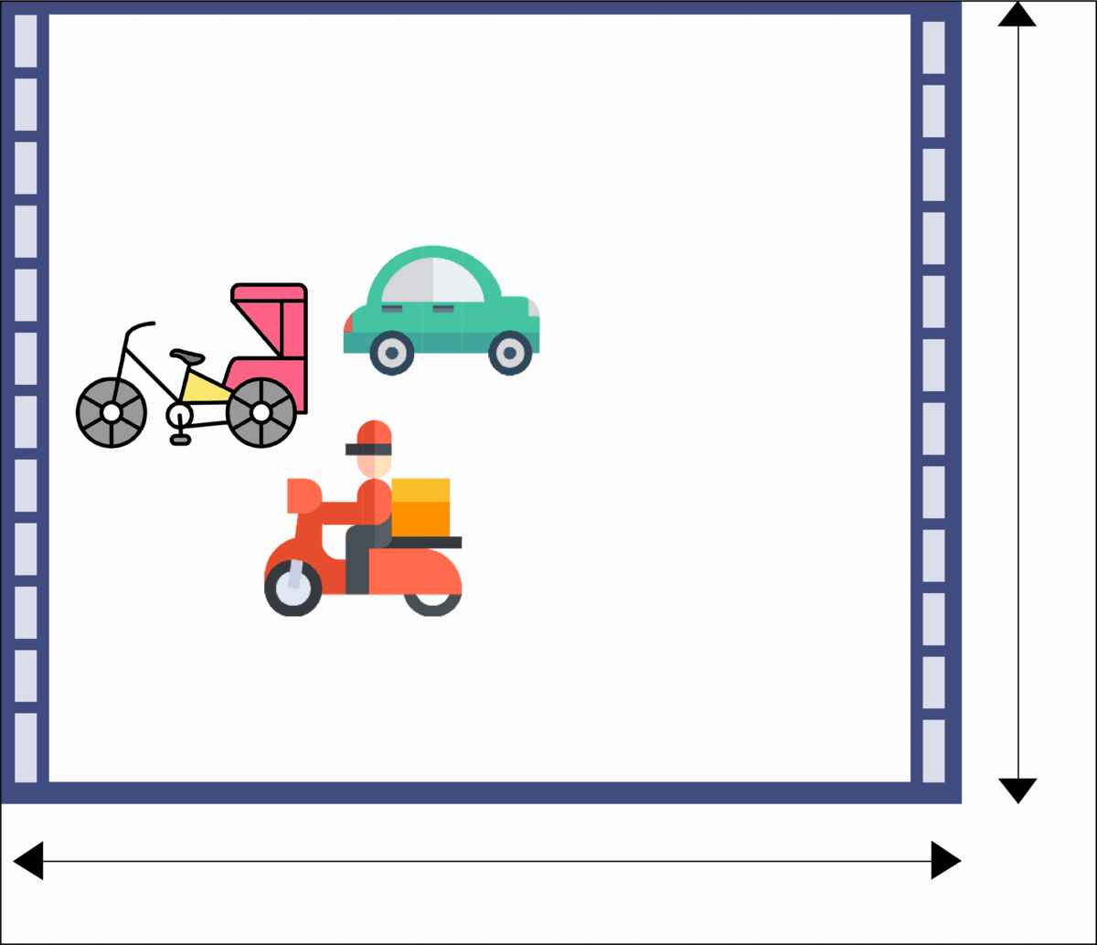
STEP 3 :
In Image Processing,
we skipped blur and hazy images. All images are reduced to 64px to 64 px & size under 40kb image format is JPG

Slide 23
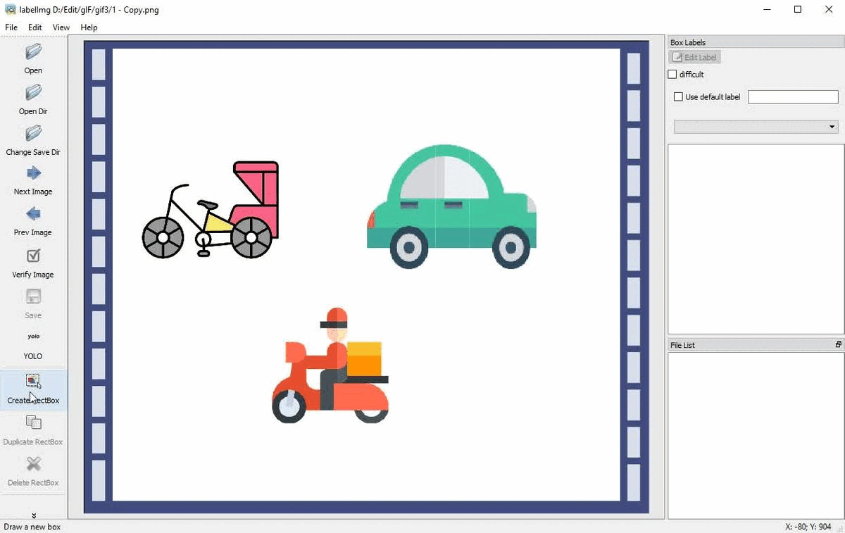
STEP 4 :
Annotating Images
Using LabelIMG

Slide 24
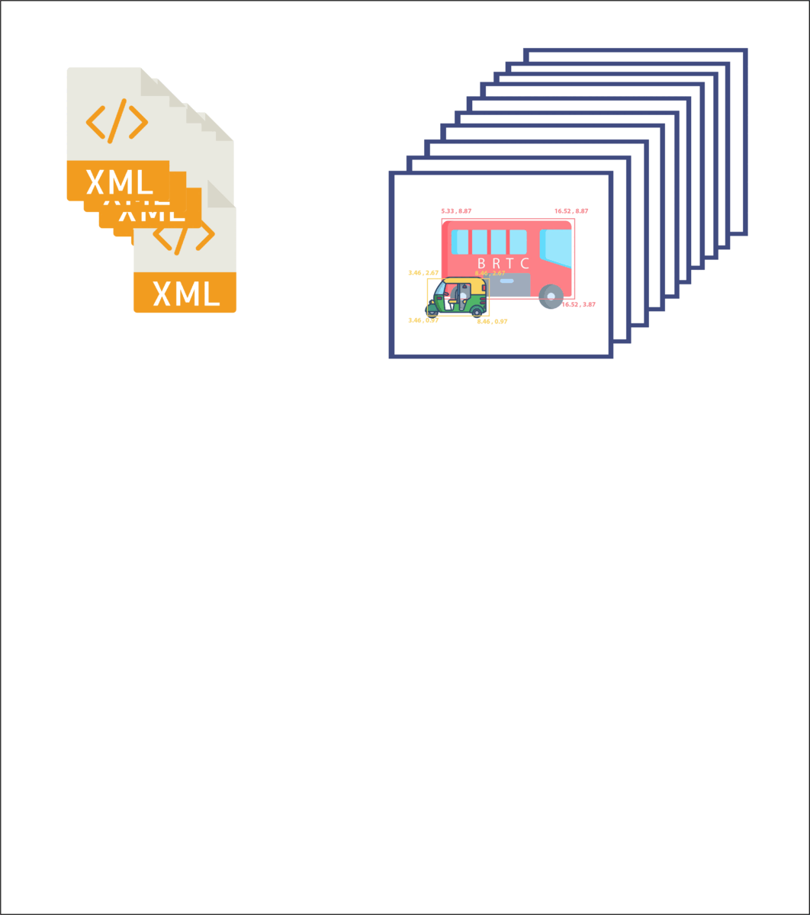
STEP 5 :
Dividing Images and labels in train and test.

Slide 25
Vehicle Detection

Slide 26
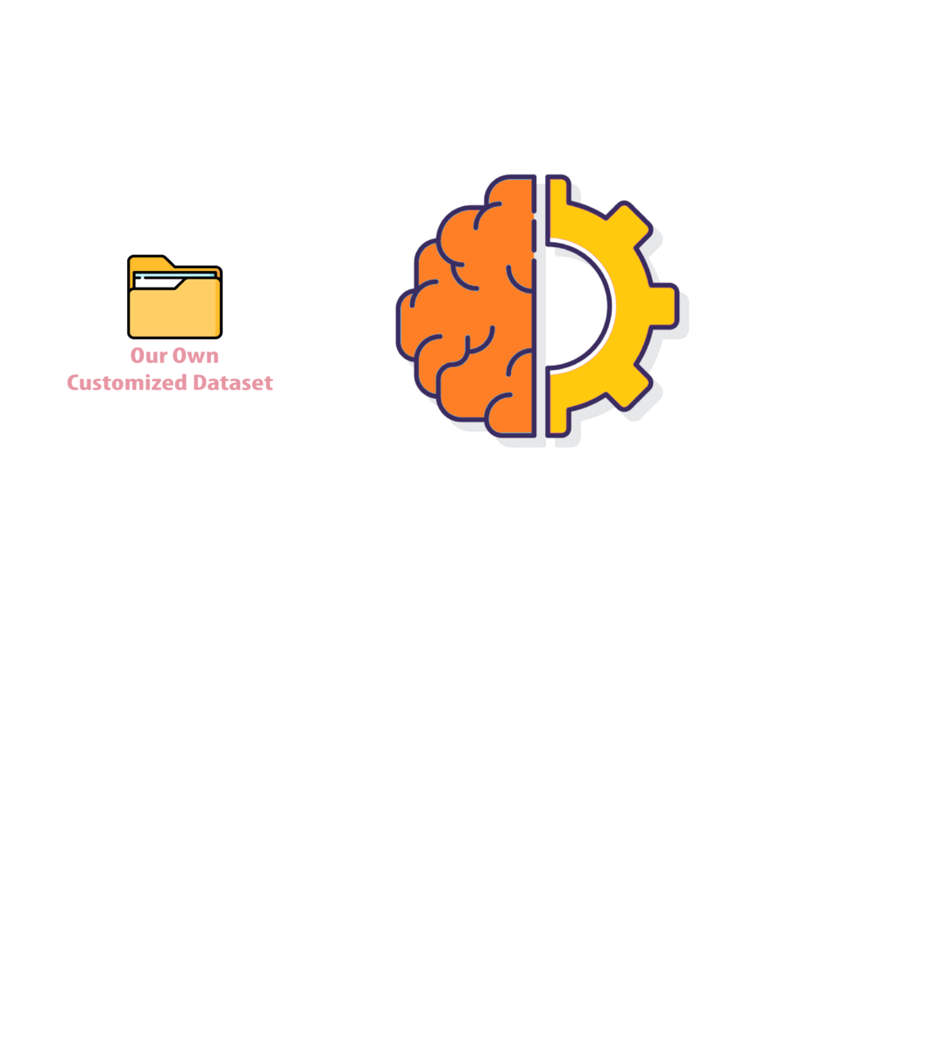
Steps Include Here :
Using Deep Learning
Modules
Training Data
Testing Data
Show Detection Result

Slide 27

Steps Include Here :
Using Deep Learning
Modules
Training Data
Testing Data
Show Detection Result

Slide 28
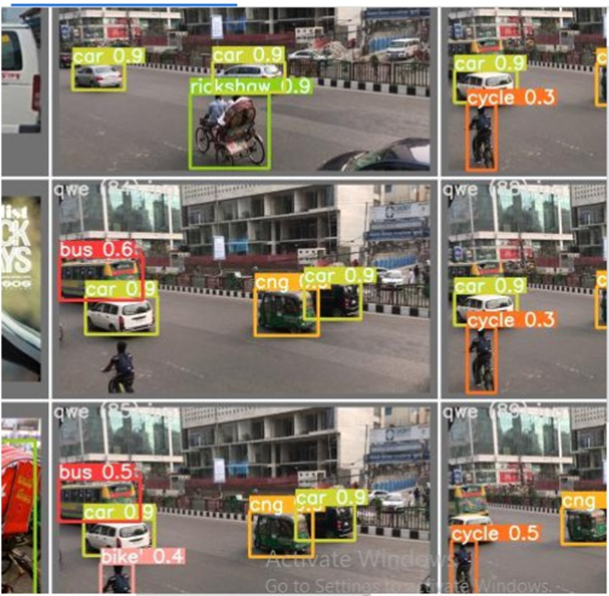
Model Training using Trained Data
YOLO v5
Fig: Vehicle detection using YOLO v5

Slide 29
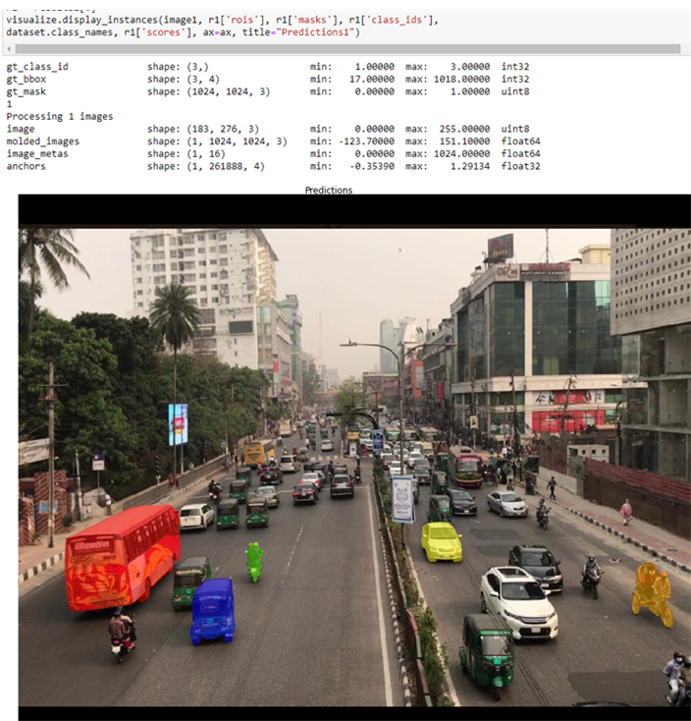
Model Training using Trained Data
Mask R-CNN
Fig: Vehicle detection using Mask R-CNN

Slide 30
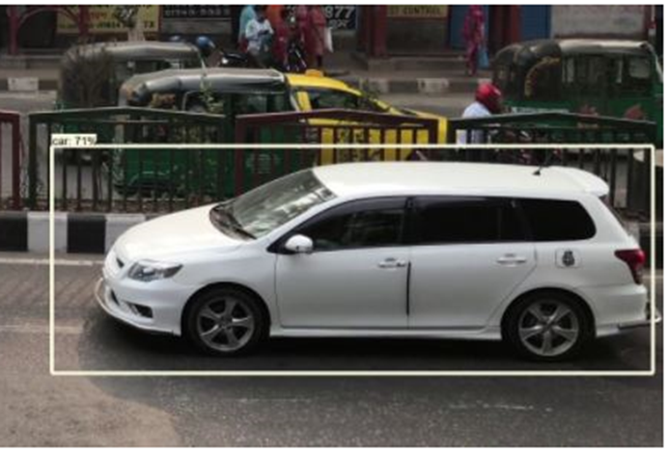
Model Training using Trained Data
SSD
(Single Shot MultiBox Detector)
Fig: Vehicle detection using SSD

Slide 31
Vehicle Tracking

Slide 32
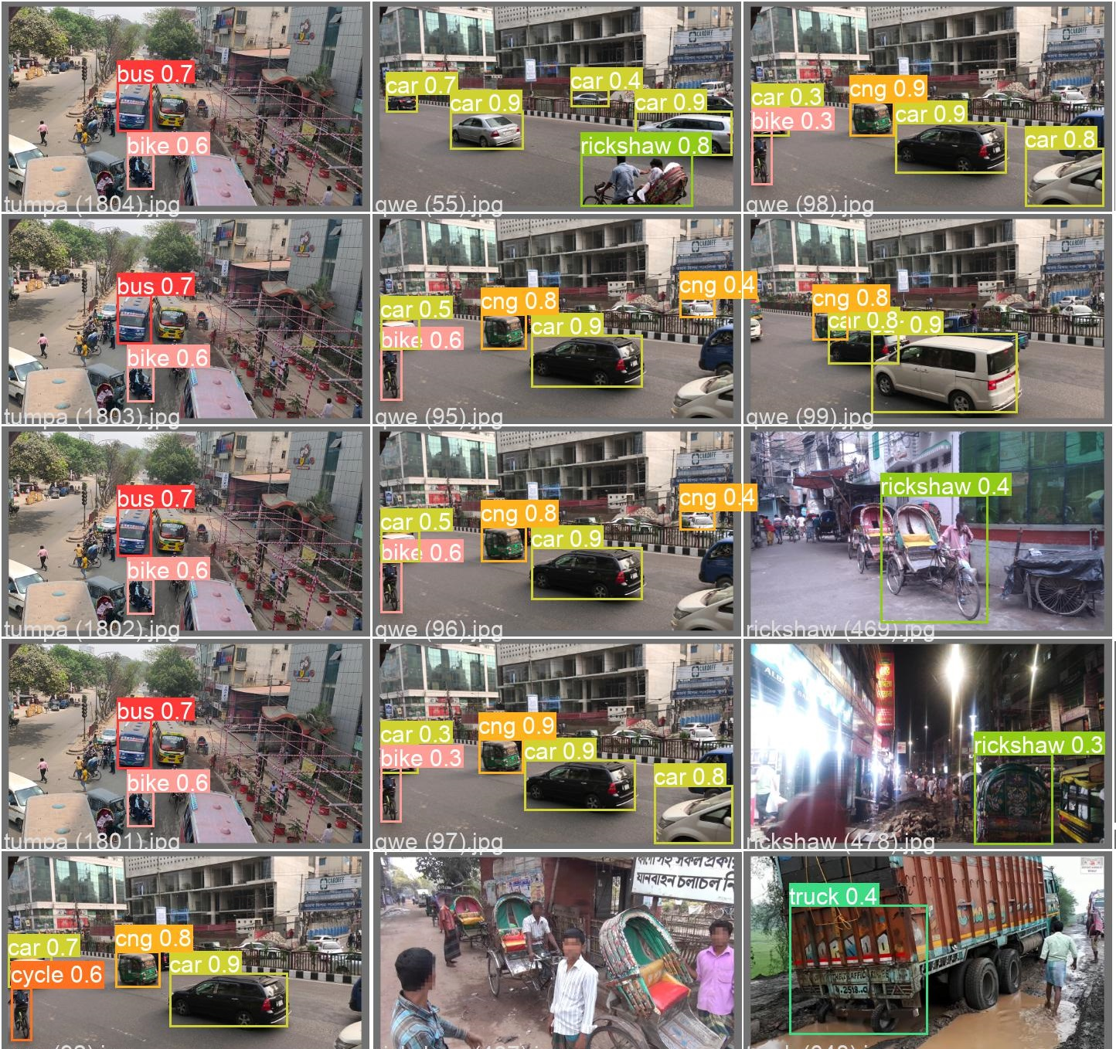
Model Training using Trained Data
YOLO v5
Fig: Vehicle tracking using YOLO v5

Slide 33
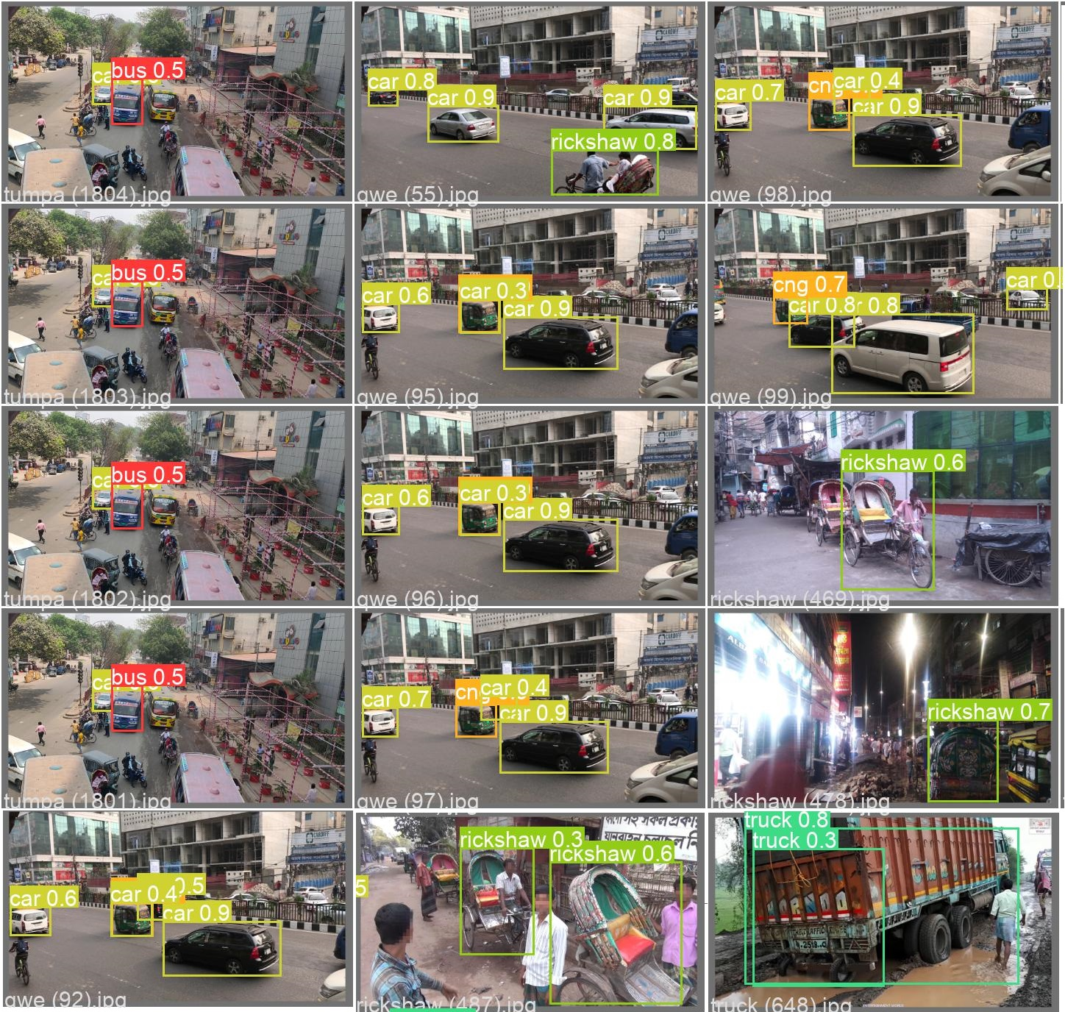
Model Training using Trained Data
DeepSort
Fig: Vehicle tracking using DeepSort

Slide 34
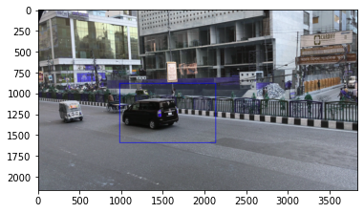
Model Training using Trained Data
GOTURN
Fig: Vehicle tracking using GOTURN

Slide 35
Practical Visualization

Slide 36
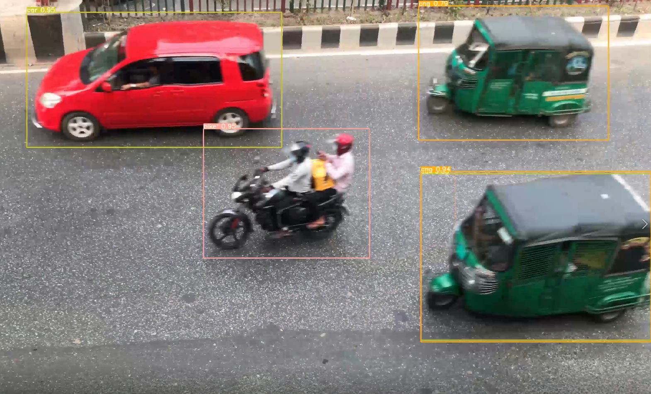
Vehicle Detection

Slide 37
Vehicle Tracking ( YoloV5 + DeepSort )

Slide 38
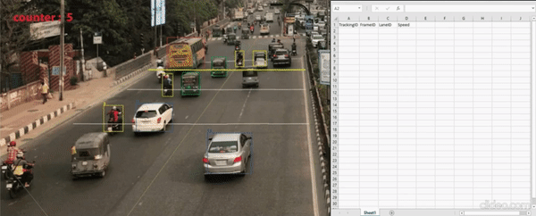
Vehicle Counting and Speed Estimation

Slide 39
Result Analysis

Slide 40
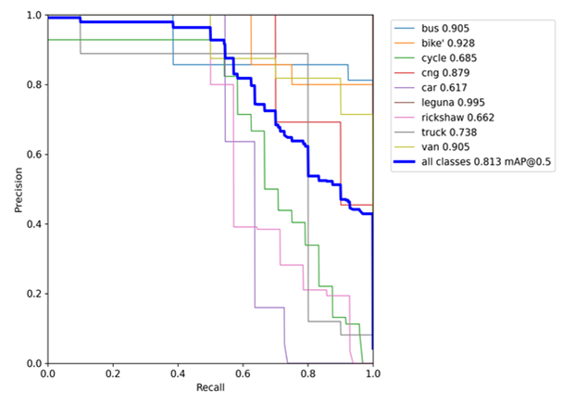
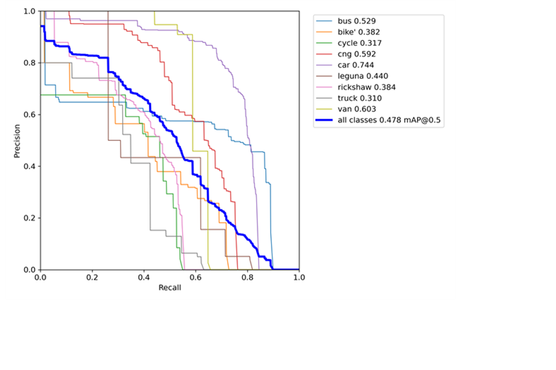
Performance of YOLO v5
Fig: Result of test data(1000+) using YOLO v5
Fig: Result of test data(8000+) using YOLO v5

Slide 41
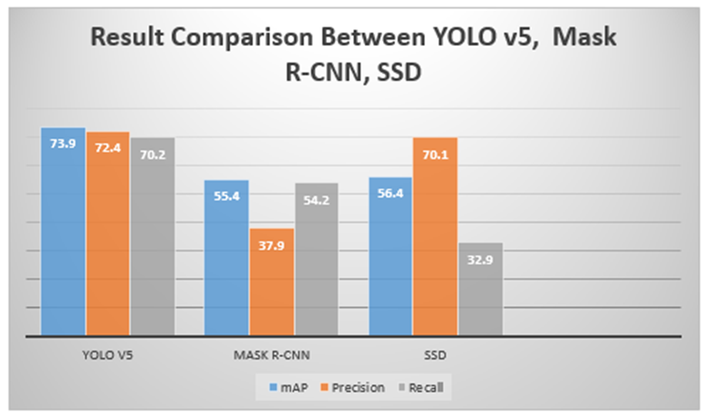
Comparison of Deep Learning Models
Fig: Result Comparison of YOLO v5, Mask R-CNN, SSD

Slide 42
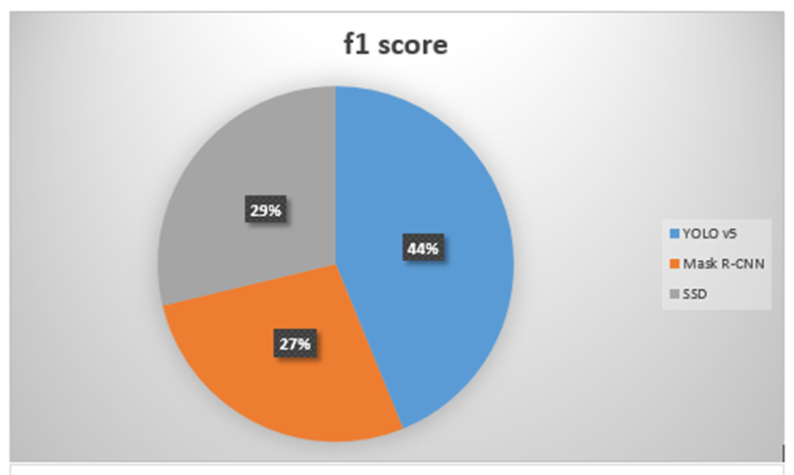
Performance of Deep Learning Models for Detection
Fig: Performance of YOLO v5, Mask R-CNN, SSD

Slide 43
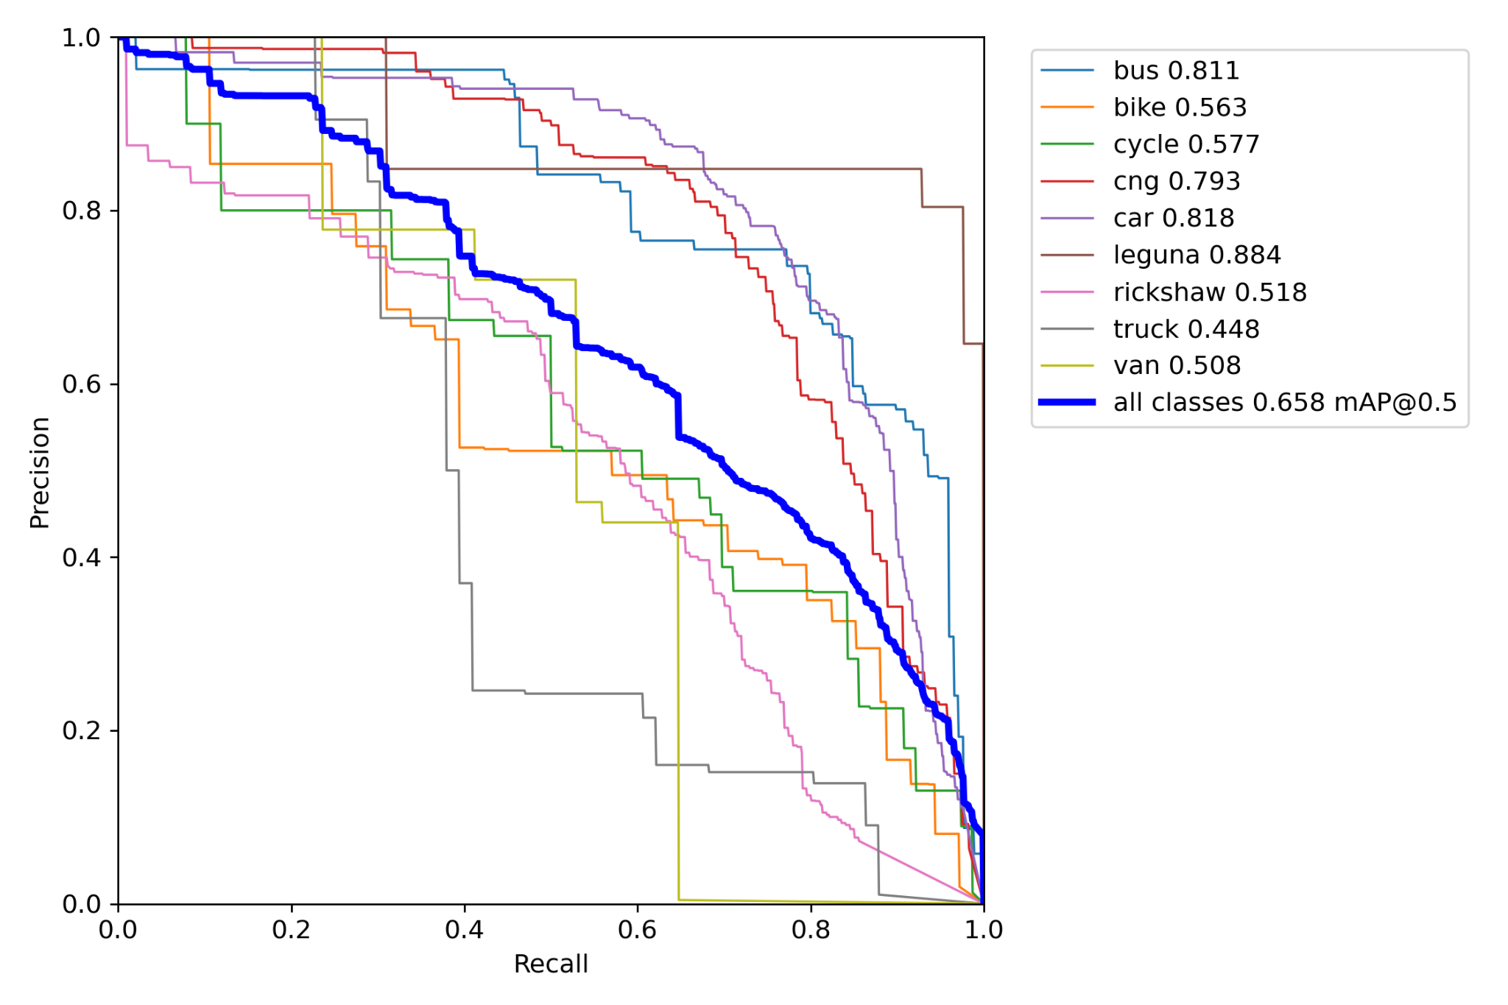
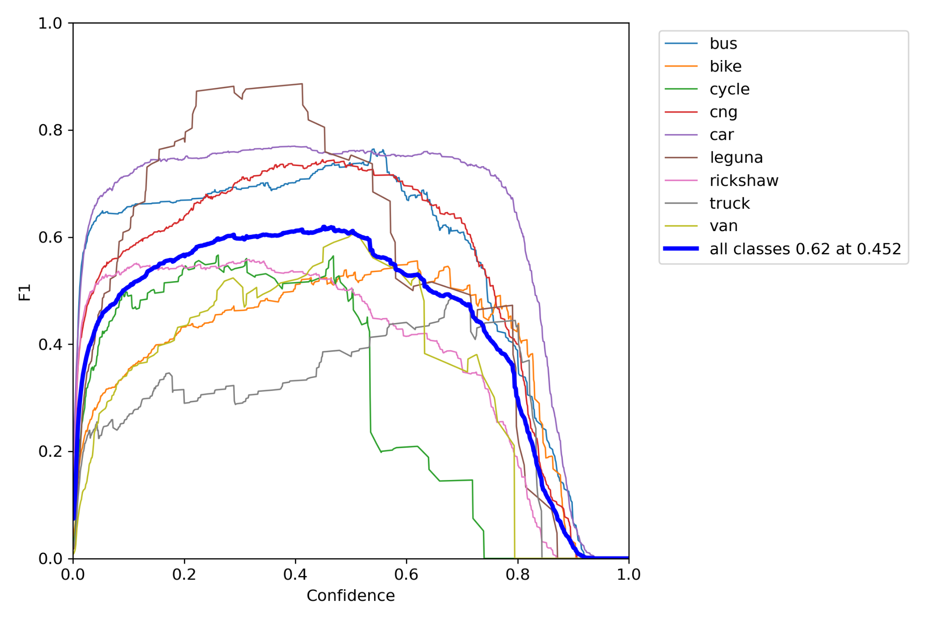
Performance of YOLO v5 for Tracking:
Fig: Result of test data(8000+) using YOLO v5
Fig: F1 curve of test data(8000+) using YOLO v5

Slide 44
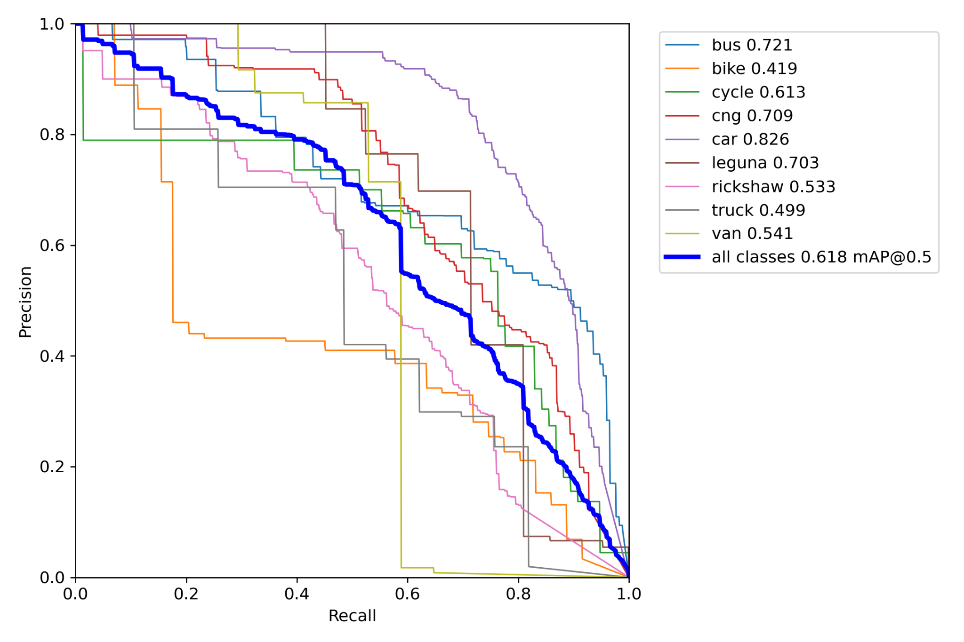
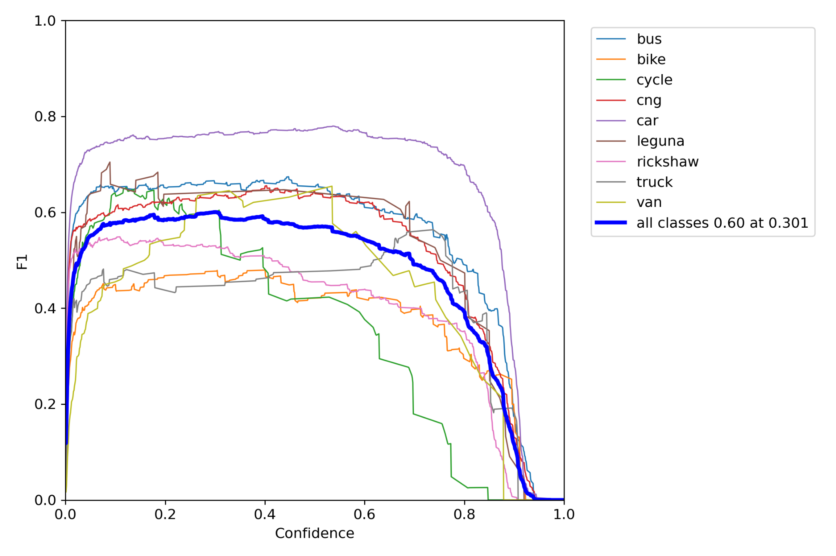
Performance of DeepSORT for Tracking:
Fig: Result of test data(8000+) using DeepSORT
Fig: F1 curve of test data(8000+) using DeepSORT

Slide 45
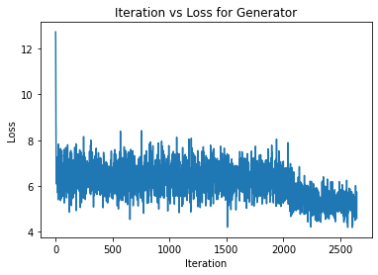
Performance of GOTURN for Tracking:
Fig: Loss curve of test data(8000+) using GOTURN

Slide 46
Our future work includes making a full vehicle identifying
System which will:
Differentiate a certain categorized vehicle detection
from others
Estimate lane changing
Differentiate the low speed and high speed
Vehicles
Predict in which direction a vehicle will go
Future
Work

Slide 47
Conclusion
Vehicle detection and tracking applications play an important role for civilian applications such as in highway traffic surveillance control, management and urban traffic planning. As there is no work similar to this field in the perspective of Bangladesh, so it’ll be highly beneficial for future if we can implement it as we have thought to do.

Slide 48
References
1. S. Sri Jamiya and E. Rani, “A survey on vehicle detection and tracking algorithms in real time video surveillance,”
2. R. A. Hadi, G. Sulong, and L. E. George, “Vehicle detection and tracking techniques: a concise review,” arXiv preprint arXiv:1410.5894, 2014.
3.J. Redmon, S. Divvala, R. Girshick, and A. Farhadi, “You only look once: Unified, realtime object detection,” in Proceedings of the IEEE conference on computer vision and pattern recognition, pp. 779–788, 2016.
4. K. He, G. Gkioxari, P. Dollár, and R. Girshick, “Mask r-cnn,” in Proceedings of the IEEE international conference on computer vision, pp. 2961–2969, 2017.
5.W. Liu, D. Anguelov, D. Erhan, C. Szegedy, S. Reed, C.-Y. Fu, and A. C. Berg, “Ssd:Single shot multibox detector,” in European conference on computer vision, pp. 21–37,Springer, 2016.

Slide 49
References (Continued)
6. R. Girshick, J. Donahue, T. Darrell, and J. Malik, “Region-based convolutional networks
for accurate object detection and segmentation,” IEEE transactions on pattern
analysis and machine intelligence, vol. 38, no. 1, pp. 142–158, 2015.
7. A. Ambardekar, M. Nicolescu, and G. Bebis, “Efficient vehicle tracking and classification
for an automated traffic surveillance system,” Signal and Image Processing, pp. 1–6, 2008.
8. “tzutalin/labelImg.” https://github.com/tzutalin/labelImg. Accessed: 2021-06-15.
9. “Make Sense.” https://www.makesense.ai/. Accessed: 2021-05-10.

Slide 50
Thank You
Any Questions?

